Slide 1

GLOBAL ANIMAL EXTINCTION INTELLIGENCE PLATFORM
GLOBAL ANIMAL EXTINCTION INTELLIGENCE PLATFORM
Review - 2
Team Members
R. Bhanu – 2420090082
V. Abhinav – 2420090086
B. Vishvak sai – 2420090024
Under the Guidance of
Associate Professor Dr. N. Sirisha

Slide 2
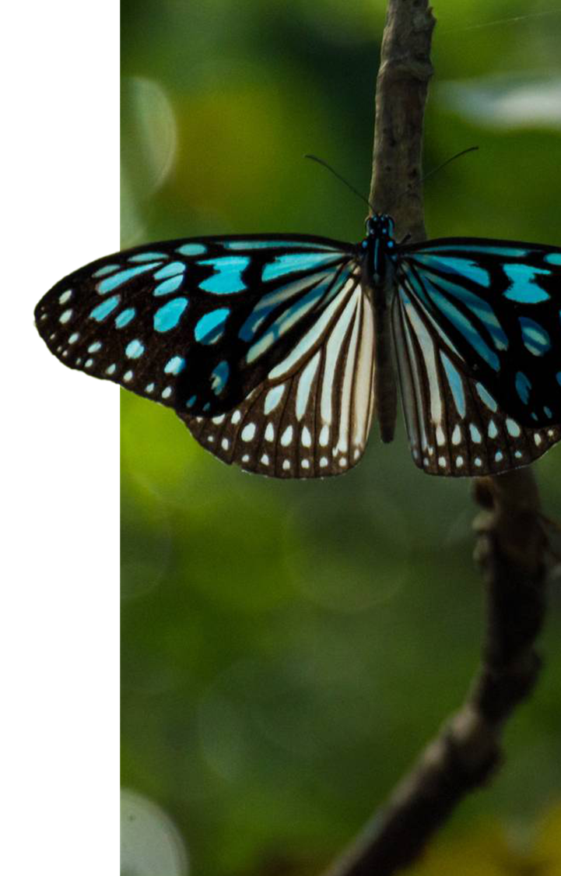
objectives
1, To collect animal and environmental data from multiple sources.
2, To clean, transform, and integrate the collected data using an ELT pipeline.
3, To analyze species information, population trends, threats, and geographical distribution.
4, To apply AI/ML techniques to identify patterns related to species extinction risk.
5, To provide meaningful insights through interactive dashboards and maps.

Slide 3

Literature Survey
IUCN Red List: Provides information about species, conservation status, threats, and extinction risk.
GBIF: Provides large-scale biodiversity and species occurrence data from different sources.
Existing ML Research: Machine learning techniques have been used to predict and analyze extinction risk using species and environmental features.
Research Gap: Existing sources provide valuable information separately, but integrating species, threat, environmental, and geographical data into a single analytics platform remains challenging.

Slide 4
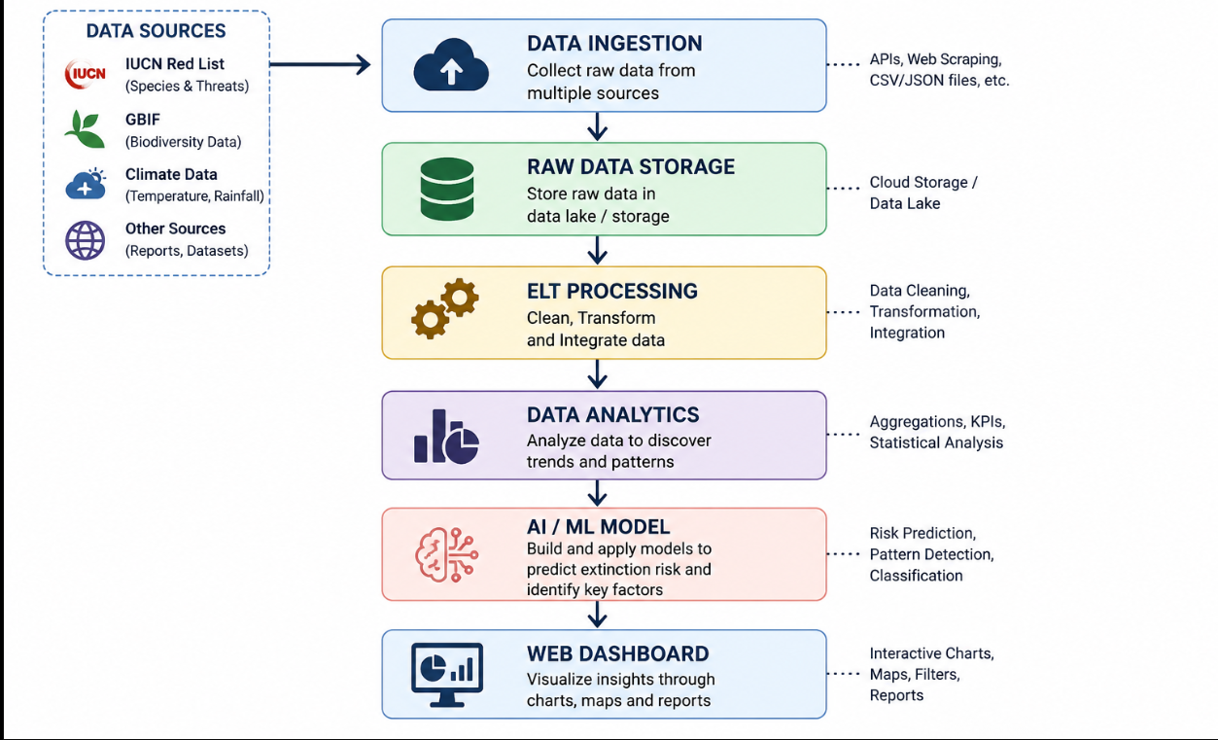
System Architecture

